Slide 1

Nescafe Gold Blend
DRD Template
February 2022
Nescafe Dolce Gusto
MMX Topline Results – Machine Sales
May 2022

Slide 2
Project Scope
Characteristics
Details
Target Brand
Nestle Dolce Gusto (NDG)
Granularity
National Level
Market Breakdown
National - Total Japan
Regions - NA
Time Period
FY 2019 - 52 WE 12/30/2019
FY 2020 – 52 WE 12/28/2020
FY 2021 – 52 WE 12/27/2021
Total Analysis: 156 Weeks
[ 12/31/2018 – 12/27/2021]
Dependent Variable
1. Machine Sales
Independent Variables
Cumulative Machine Counts, Website, Tweet Counts, Aided Awareness, Temperature, TV, Digital Media, Trade etc.
Reporting Results
Model Results, Due-to, ROI and Simulation

Slide 3
Model Inputs:
Own Ad
Non-Ad
Category | Variables Used | Data Definition
Static | DV360 | Impressions
Static | FB | Impressions
Static | GDN | Impressions
Static | LINE | Impressions
Static | Others | Impressions
Static | Smart news | Impressions
Static | Teads | Impressions
Static | Twitter | Impressions
Static | Yahoo SPBP | Impressions
Static | YDN | Impressions
Video | FB | Impressions
Video | LINE | Impressions
Video | Premium View | Impressions
Video | Teads | Impressions
Video | True view | Impressions
Video | Tver | Impressions
Video | TW | Impressions
Others | GAW | Impressions
Others | YSS | Impressions
Others | AFF | Spend
Others | PSD | Spend
TV | TV Spot | GRPs
TV | TV Time | GRPs
Variables Used | Data Definition
Tweets | Count of Tweets
Purchase Intent | Purchase Intent in %
Instore ID POS | Instore event ID POS
Instore Sales Demo | Instore event sales
Instore Rental Demo | Instore Rental Demo
Website PV | Top Page Views
Awareness | Awareness for NDG in %
Cumulative Machine Counts | Cumulative Number of Applicants to Date
Temperature | Degrees Celsius
Holiday
New Year
Base trend
FY 2019 – 52 weeks ending Dec 2019
FY 2020 – 52 weeks ending Dec 2020
FY 2021 – 52 weeks ending Dec 2021

Slide 4
SECTION 01
KPI

Slide 5
Model Fit - KPI – Machine Sales
 | R-Square | MAPE
Model Statistics | 91.6% | 8.3%
Actual Vs. Predicted
Machine Sales
Source: Analytic Edge Models
Note:

Slide 6
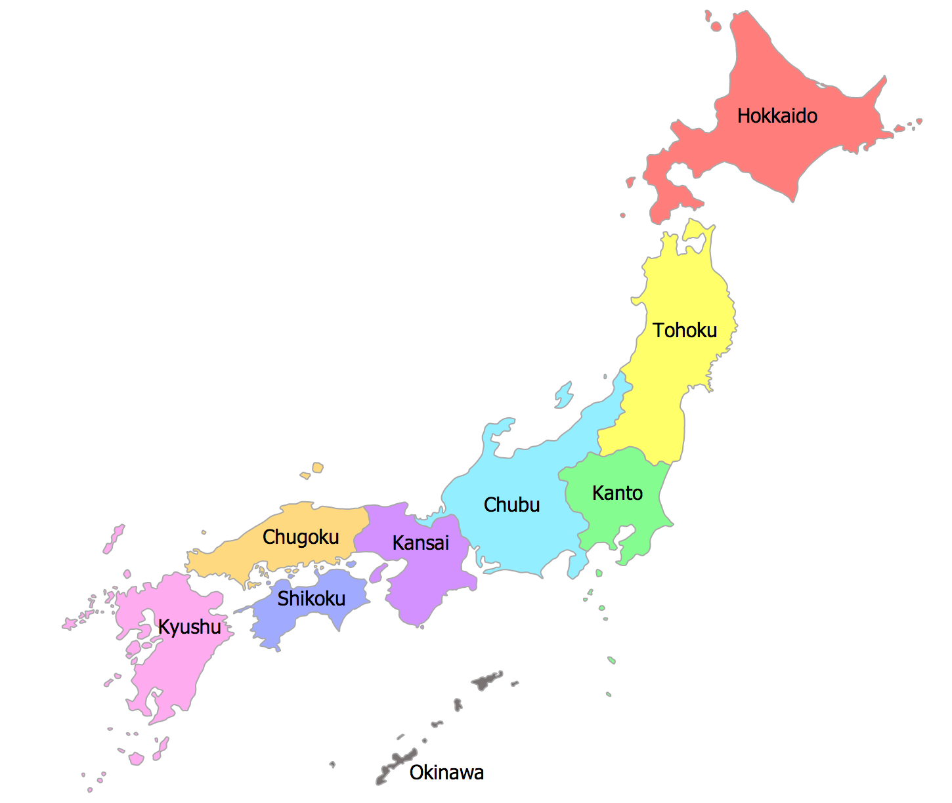
NDG Sales decreased in 2021 by 23%
 | 2019 | % Change 2020 vs 2019 | 2020 | % Change 2021 vs 2020 | 2021 | Total
Machine Sales | 170,815 | -12% | 150,315 | -23% | 115,832 | 436,963
FY 2019 – 52 weeks ending Dec 2019
FY 2020 – 52 weeks ending Dec 2020
FY 2021 – 52 weeks ending Dec 2021

Slide 7
Business Questions
To understand the Media and Non-Media impact on Sales
1
To understand which Ad drivers to focus on to increase the Sales
2
To understand how the Ad drivers spends affect the Sales increase
3
To understand which digital media, contribute to increase the Sales
4
To understand the re-allocation of the investment across the Ad drivers to increase the Sales
5

Slide 8
SECTION 02
Due-to & Contribution

Slide 9
NDG Sales declined in 2021 by around 23%
12.0%
22.9%
170,815
150,315
115,832
FY 2019 – 52 weeks ending Dec 2019
FY 2020 – 52 weeks ending Dec 2020
FY 2021 – 52 weeks ending Dec 2021
Note- Sales includes POS
Source : Analytic Edge Models

Slide 10
Total Due-To
2020 vs 2019
2021 vs 2020
Note- Sales includes POS
Source : Analytic Edge Models

Slide 11
Due-To : Own Ad
2020 vs 2019
2021 vs 2020
CHANGE IN SUPPORT
CHANGE IN SUPPORT
56%
-29%
--
++
-33%
-80%
-8%
-75%
-77%
-41%
--
++
Note- Sales includes POS
Source : Analytic Edge Models

Slide 12
Support Summary : Own Ad
Support | Metric | 2019 | 2020 | 2021
Static | Impressions (in Mio.) | 245.8 | 383.3 | 272.5
Video | Impressions (in Mio.) | 5.2 | - | 103.4
YSS | Impressions (in Mio.) | 13.7 | 9.3 | 1.8
GAW | Impressions (in Mio.) | 8.0 | 7.4 | 1.8
AFF | Spends (in Mio. JPY) | 105.8 | 23.8 | 14.1
TV | GRPs (in 000’s) |  |  | 1.3
56%
-29%
-33%
-80%
-8%
-75%
-77%
-41%
Note- Sales includes POS
Source : Analytic Edge Models

Slide 13
Due-To : Non-Ad
2020 vs 2019
2021 vs 2020
CHANGE IN SUPPORT
CHANGE IN SUPPORT
-38%
117%
1.0 pt.
-0.4 pt.
-2,700 pt.
-1,596 pt.
-1,987 pt.
2,657 pt.
-9,491 pt.
7,685 pt.
-18%
-4%
5.3 C
0.1 C
3.3 mio. Pt.
2.1 mio. Pt.
--
--
--
--
--
--
--
--
--
--
Note- Sales includes POS
Source : Analytic Edge Models

Slide 14
Support Summary : Non- Ad
Support | 2019 | 2020 | 2021
Tweets | 148,275 | 91,853 | 199,431
Purchase Intent | 11.7 | 12.8 | 12.4
Instore ID POS | 4,296 | 1,596 | 0
Instore Sales Demo | 2,661 | 674 | 3,331
Instore Rental Demo | 14,537 | 5,046 | 12,731
Website Page views | 4,606,070 | 3,795,833 | 3,628,086
Temperature | 11.2 | 16.6 | 16.7
Cumulative Machine Counts(in mio.) | 38 | 41 | 44
Holiday | - | - | -
New Year | - | - | -
Base trend | - | - | -
Covid | - | - | -
-38%
++
9%
-3%
-63%
--
-75%
++
-65%
++
-18%
-4%
48%
1%
9%
5%
Note- Sales includes POS
Source : Analytic Edge Models

Slide 15
Own Ad- Volume by year
64.8%
0.4%
8,128
13,353
13,413
Spends
(Mio. JPY)
308
-52.7%
146
++
414
Note- Sales includes POS
Source : Analytic Edge Models

Slide 16
Own Ad Volume by year
% Contribution to Sales
Incremental Volume
Note- Sales includes POS
Source : Analytic Edge Models

Slide 17
Own Ad : Static Volume by year
% Contribution to Sales
Incremental Volume
Note- Sales includes POS
Source : Analytic Edge Models

Slide 18
Own Ad : Video Volume by year
% Contribution to Sales
Incremental Volume
Note- Sales includes POS
Source : Analytic Edge Models

Slide 19
Non-Ad Volume by year
% Contribution to Sales
Incremental Volume
Note- Sales includes POS
Source : Analytic Edge Models

Slide 20
SECTION 03
Efficiency

Slide 21
Static remained to be the most efficient media for NDG due to its lower cost compared to the other media tactics.
Efficiency – Own Ad
 | Spends (mio. JPY) | CPM | Spends (mio. JPY) | CPM | Spends (mio. JPY) | CPM | Spends (mio. JPY) | CPM | Spends (mio. JPY) | CPM | Spends (mio. JPY) | CPM
2019 | 90 | 365 | 9 | 1,800 | 35 | 2,553 | 68 | 8,569 | 106 | - | - | -
2020 | 49 | 128 | - | - | 22 | 2,396 | 51 | 6,955 | 24 | - | - | -
2021 | 65 | 238 | 78 | 754 | 9 | 4,746 | 21 | 11,424 | 14 | - | 228 | 171,922
Note- Sales includes POS
Source : Analytic Edge Models
Efficiency [ Incr sale per 1M JAP YEN]

Slide 22
Own Ad : Static - Efficiency
Efficiency – Own Ad
 | DV 360 |  | FB |  | GDN |  | LINE |  | Others |  | Smartnews |  | Teads |  | Twitter |  | Yahoo |  | YDN
Spends (mio. JPY) | Spends | CPM | Spends | CPM | Spends | CPM | Spends | CPM | Spends | CPM | Spends | CPM | Spends | CPM | Spends | CPM | Spends | CPM | Spends | CPM
2019 | 6.5 | 122 | 7.1 | 1,664 | 25.9 | 186 |  |  | 3.6 | 480 |  |  | 18.7 | 1,395 | 3.0 | 228 | 25.0 | 1,674
2020 | 1.3 | 783 | 16.5 | 436 | 12.2 | 128 | 7.5 | 203 | 0.9 | 246 | 5.0 | 27 |  |  |  |  |  |  | 5.8 | 255
2021 |  |  | 31.1 | 962 | 9.4 | 113 | 7.8 | 237 | 3.4 | 324 |  |  | 0.6 | 1,231 | 4.7 | 298 |  |  | 7.9 | 81
Note- Sales includes POS
Source : Analytic Edge Models
Efficiency [ Incr sale per 1M JAP YEN]

Slide 23
Own Ad : Video- Efficiency
Efficiency – Own Ad
 | Spends (mio. JPY) | CPM | Spends (mio. JPY) | CPM | Spends (mio. JPY) | CPM | Spends (mio. JPY) | CPM | Spends (mio. JPY) | CPM | Spends (mio. JPY) | CPM | Spends (mio. JPY) | CPM | Spends (mio. JPY) | CPM
2019 | 3 | 1,919 |  |  |  |  |  |  | 6 | 1,749
2021 | 17 | 447 | 1 | 200 | 6 | 4,502 | 3 | 2,075 | 15 | 623 | 31 | 2,225 | 3 | 239 | 1 | 331
Note- Sales includes POS
Source : Analytic Edge Models
Efficiency [ Incr sale per 1M JAP YEN]

Slide 24
Efficiency and contribution by Own tactics –2019
Efficiency =
Incremental Sales
Spends of 1 JPY mio.
Note- Sales includes POS
Source : Analytic Edge Models

Slide 25
Efficiency and contribution by Own tactics –2020
Efficiency =
Incremental Sales
Spends of 1 JPY mio.
Note- Sales includes POS
Source : Analytic Edge Models

Slide 26
Efficiency and contribution by Own tactics –2021
Efficiency =
Incremental Sales
Spends of 1 JPY mio.
Note- Sales includes POS
Source : Analytic Edge Models

Slide 27
Efficiency and contribution by Own tactics(Static) –2019
Efficiency =
Incremental Sales
Spends of 1 JPY mio.
Note- Sales includes POS
Source : Analytic Edge Models

Slide 28
Efficiency and contribution by Own tactics(Static) –2020
Efficiency =
Incremental Sales
Spends of 1 JPY mio.
Note- Sales includes POS
Source : Analytic Edge Models

Slide 29
Efficiency and contribution by Own tactics(Static) –2021
Efficiency =
Incremental Sales
Spends of 1 JPY mio.
Note- Sales includes POS
Source : Analytic Edge Models

Slide 30
Efficiency and contribution by Own tactics(Video) –2021
Efficiency =
Incremental Sales
Spends of 1 JPY mio.
Note- Sales includes POS
Source : Analytic Edge Models

Slide 31
SECTION 04
Effectiveness

Slide 32
Own Ad : Effectiveness
Effectiveness – Own Ad
 | Support (mio) | Incr. Sales | Support (mio) | Incr. Sales | Support (mio) | Incr. Sales | Support (mio) | Incr. Sales | Support (000’) | Incr. Sales
2019 | 246 | 5,355 | 5 | 99 | 14 | 520 | 8 | 268 | - | -
2020 | 384 | 12,225 | - | - | 9 | 358 | 7 | 283 | - | -
2021 | 272 | 10,320 | 103 | 2,643 | 2 | 71 | 2 | 64 | 1 | 133
Note- Sales includes POS
Source : Analytic Edge Models
Effectiveness [ Incremental Sales / Support]

Slide 33
Own Ad : Static - Effectiveness
Effectiveness – Own Ad
 | DV 360 |  | FB |  | GDN |  | LINE |  | Others |  | Smartnews |  | Teads |  | Twitter |  | Yahoo |  | YDN
Support (mio.) | Support | Incr. Sales | Support | Incr. Sales | Support | Incr. Sales | Support | Incr. Sales | Support | Incr. Sales | Support | Incr. Sales | Support | Incr. Sales | Support | Incr. Sales | Support | Incr. Sales | Support | Incr. Sales
2019 | 53 | 1,591 | 4 | 739 | 139 | 1,429 |  |  | 7 | 270 |  |  | 13 | 16 | 13 | 1,286 | 15 | 23
2020 | 2 | 51 | 38 | 6,764 | 95 | 979 | 37 | 2,342 | 4 | 83 | 185 | 1,737 |  |  |  |  |  |  | 23 | 269
2021 |  |  | 32 | 5,365 | 83 | 674 | 33 | 1,791 | 10 | 432 |  |  | 1 | 1 | 16 | 1,318 |  |  | 97 | 739
Note- Sales includes POS
Source : Analytic Edge Models
Effectiveness [ Incremental Sales / Support]

Slide 34
Own Ad : Video- Effectiveness
Effectiveness – Own Ad
 | Support (mio) | Incr. Sales | Support (mio) | Incr. Sales | Support (mio) | Incr. Sales | Support (mio) | Incr. Sales | Support (mio) | Incr. Sales | Support (mio) | Incr. Sales | Support (mio) | Incr. Sales | Support (mio) | Incr. Sales
2019 | 1.6 | 36 | - | - | - | - | - | - | 3.7 | 63 | - | - | - | - | - | -
2021 | 38.2 | 669 | 7.1 | 3 | 1.3 | 50 | 1.4 | 209 | 24.4 | 411 | 13.9 | 1,276 | 12.6 | 61 | 4.5 | 9
Note- Sales includes POS
Source : Analytic Edge Models
Effectiveness [ Incremental Sales / Support]

Slide 36
Appendix

